Slide 1

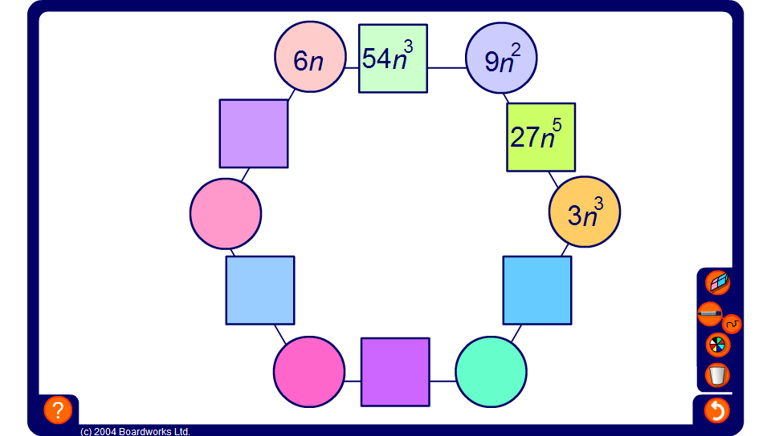


Hexagon Puzzle
Notes:
The numbers in the squares are found by multiplying the terms in the circles on either side.
Start by selecting one of the blank circles. Indicate the relevant circle and square and ask:
What would I have to multiply this term by to get this term?
(It is probably easier for pupils to find the circle terms in this way initially. Later, you may ask pupils to divide.)
Next, ask pupils to find the term in the adjacent square.
Continue until the puzzle is complete.
Discuss briefly the fact that when we multiply two terms together with the same base (the letter n, in this case) we add the powers. When we divide two terms with the same base (the letter n) we subtract the powers.

